Slide 1
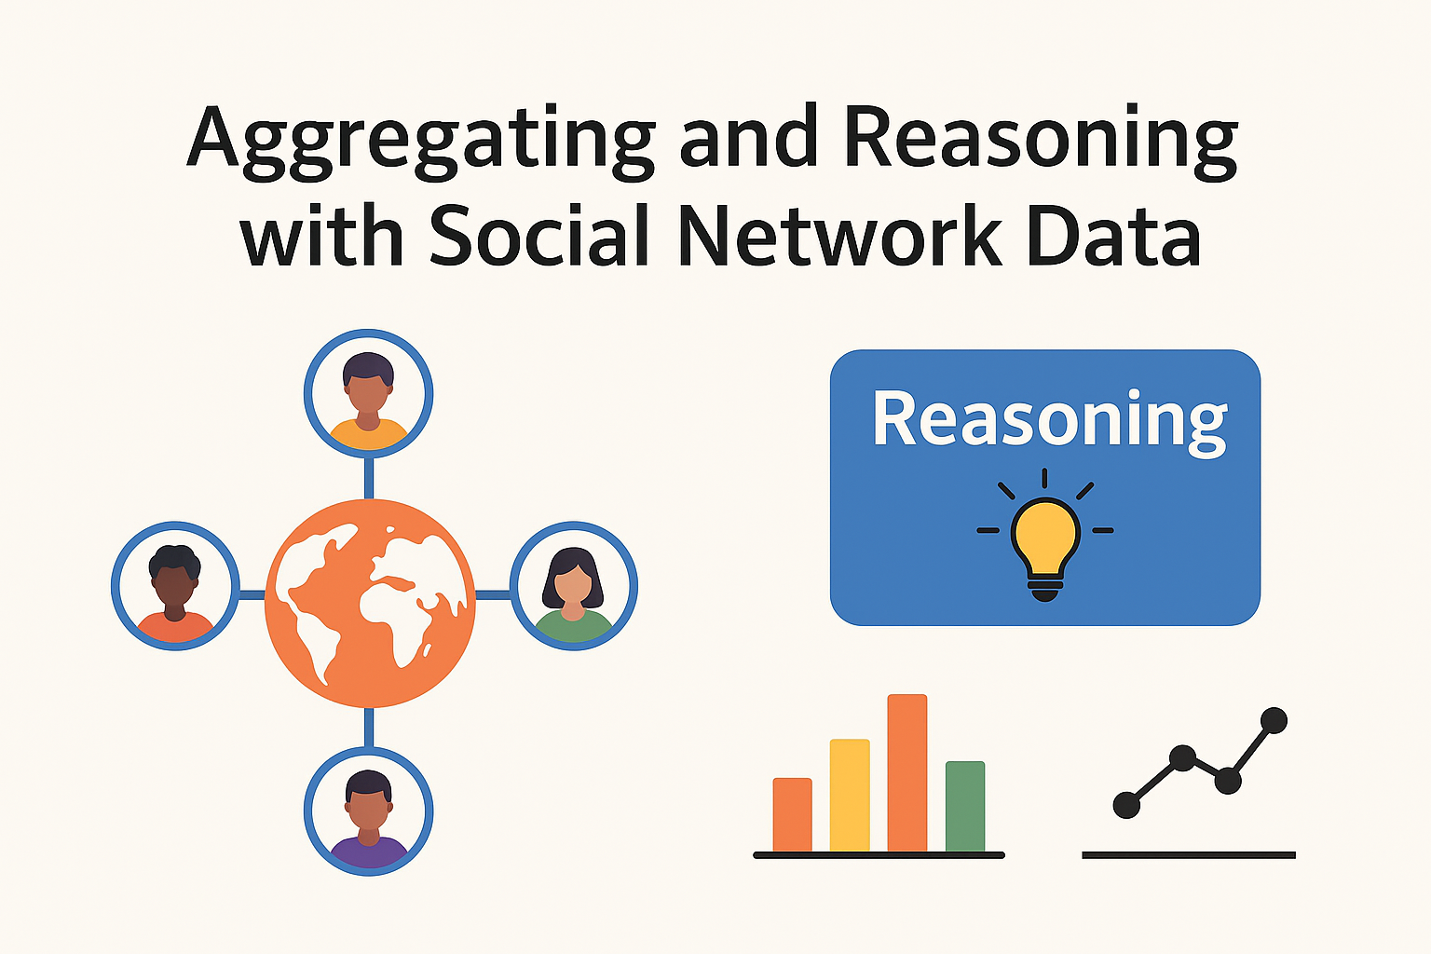
SHIMNA SHERIN

Slide 2
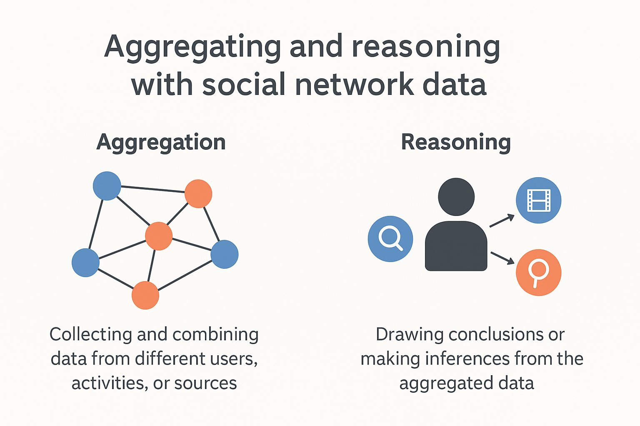

Slide 3
Aggregating Social Network Data
Aggregation means collecting and combining data from multiple sources, users, or interactions in a social network to get a bigger picture.
Examples:
Combining likes, comments, and shares across posts to measure popularity.
Merging data from different platforms (Facebook + Twitter) to analyze a person’s influence.
Summarizing group activities to find common interests.
Why aggregate?
To identify trends, patterns, or communities.
To simplify massive, scattered data into usable form.
To prepare data for further analysis (like machine learning).

Slide 4
Reasoning with Social Network Data
Reasoning means drawing logical conclusions or inferences from the aggregated data. It uses algorithms, rules, or semantic techniques to answer questions like:
“Are two people likely to know each other?” (link prediction)
“What group does this user belong to?” (community detection)
“Is this account a bot or human?” (classification)
Techniques used:
Graph theory (nodes & edges).
Ontologies and semantic web rules (RDF, OWL).
Inference engines that deduce new facts (if A follows B and B follows C, maybe A and C are connected).

Slide 5
Motivation for data aggregation
Sometimes we don’t trust just one piece of information. So we take the same kind of information from many places. This is called triangulation. It’s like asking three friends the same question to make sure the answer is true.
When we join information from many places, we must keep the names and the links clear. We must know who is who and how they are connected. If we forget that, our joined-up information will be wrong.
So, data aggregation means collecting information from many places but keeping everything clear and correct.

Slide 6
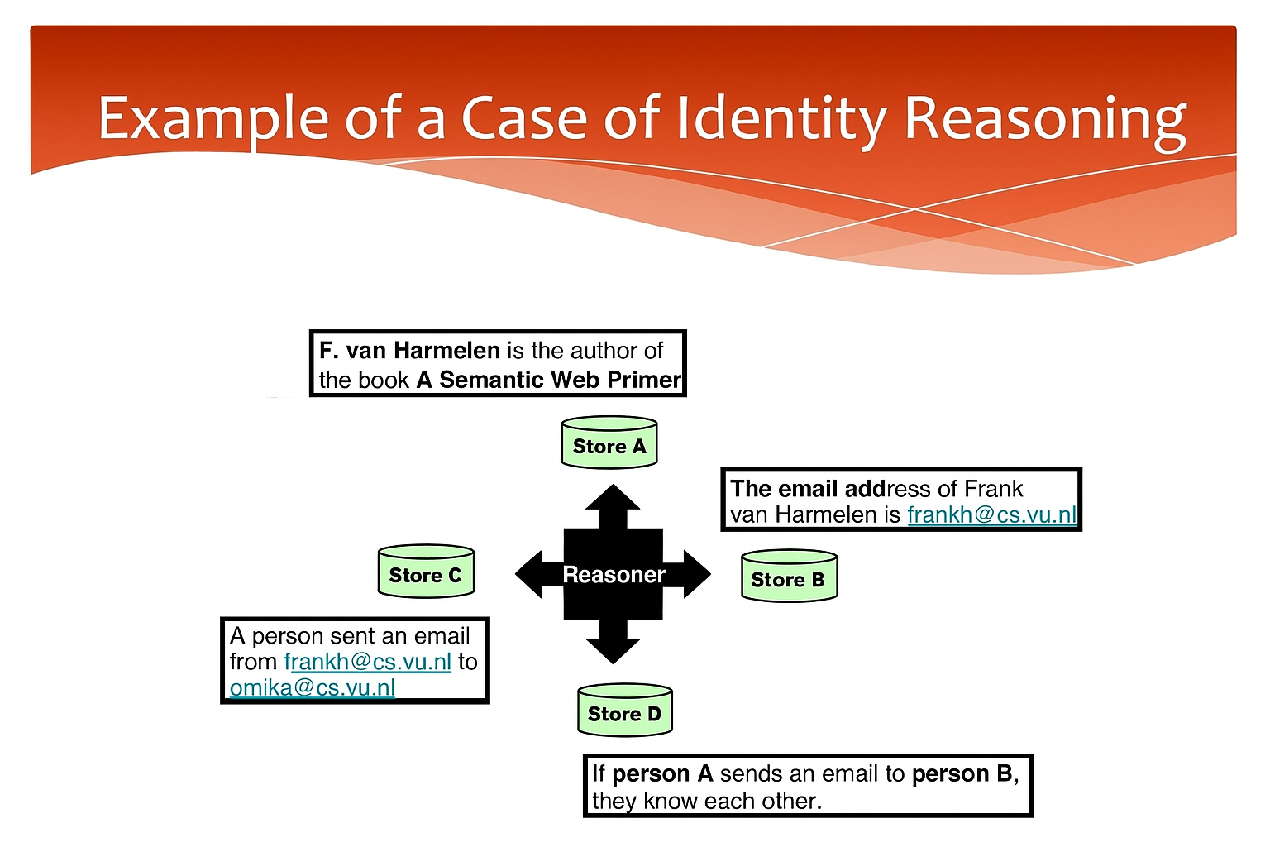

Slide 7
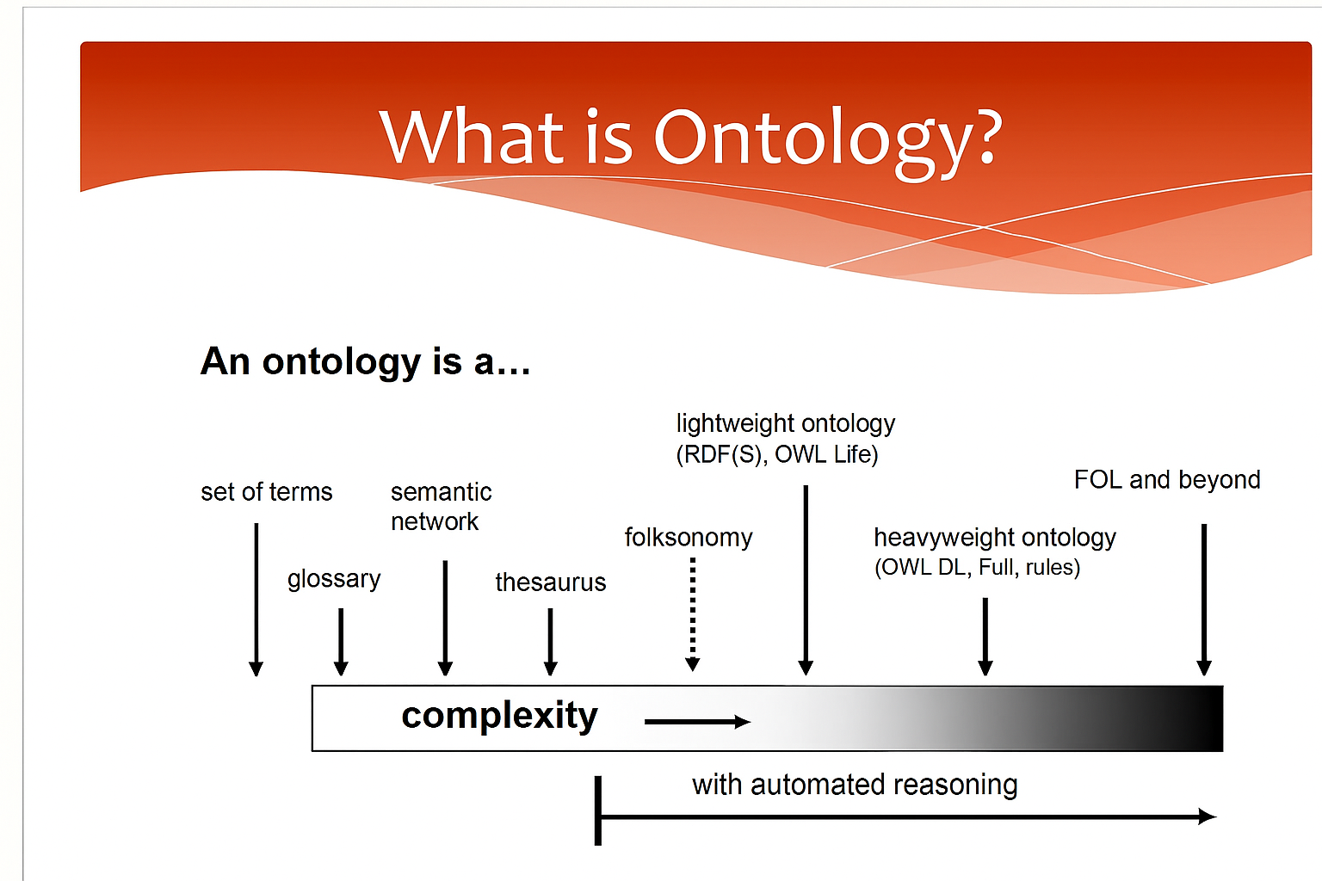

Slide 8
Aggregating And Reasoning With Social Network Data.
URI – Universal Resource Identifier – which gives every person, post or object a unique address.
We also need to do disambiguation. For example, if we see the name John Smith twice, are they the same person or two different people? Our system must tell them apart.
In OWL, which is the Web Ontology Language, there is a property called “sameAs” to state that two identifiers actually refer to the same real-world entity.
Equality. The property “sameAs” in OWL is special: it is reflexive (true about itself), symmetric (if A = B then B = A) and transitive (if A = B and B = C then A = C). This helps machines reason correctly about identities.
Descriptive logic and rule-based reasoners.
Rule-based reasoners follow rules and use forward chaining and backward chaining to derive conclusions.
Descriptive logic is used mainly for classification and to check that an ontology is consistent — in other words, that our knowledge base has no contradictions.

Slide 9
The benefits: modelling & aggregation
Explicit. Using RDF and OWL, we can clearly express and reason about what it means for two things to be the same. This is also called ‘smushing’ – combining information about the same entity from different sources.
Extendible. The system is designed to be distributed both in terms of schema and data. We can also express mappings between different schemas in the language.
Flexible. The mappings can be partial, and yet remain robust.
Standard. We have standard languages such as RDFS, OWL and SPARQL; standard vocabularies such as DC, PRISM and SWRC; and standard protocols like SPARQL. All these together make modelling and aggregation more powerful and interoperable

Slide 10
The drawbacks
Expressivity. For example, it is hard to represent complex inverse functional properties or special cases such as swrc:page or prism:startingPage and prism:endingPage.
ontology-based interchange is still partly a social engineering task. This means that even though the technology exists, people still have to agree on how to model and share the data.
Scalability. As the amount of data and the number of mappings grow, it becomes harder to manage and reason efficiently.

Slide 11
Thank you

